Slide 1
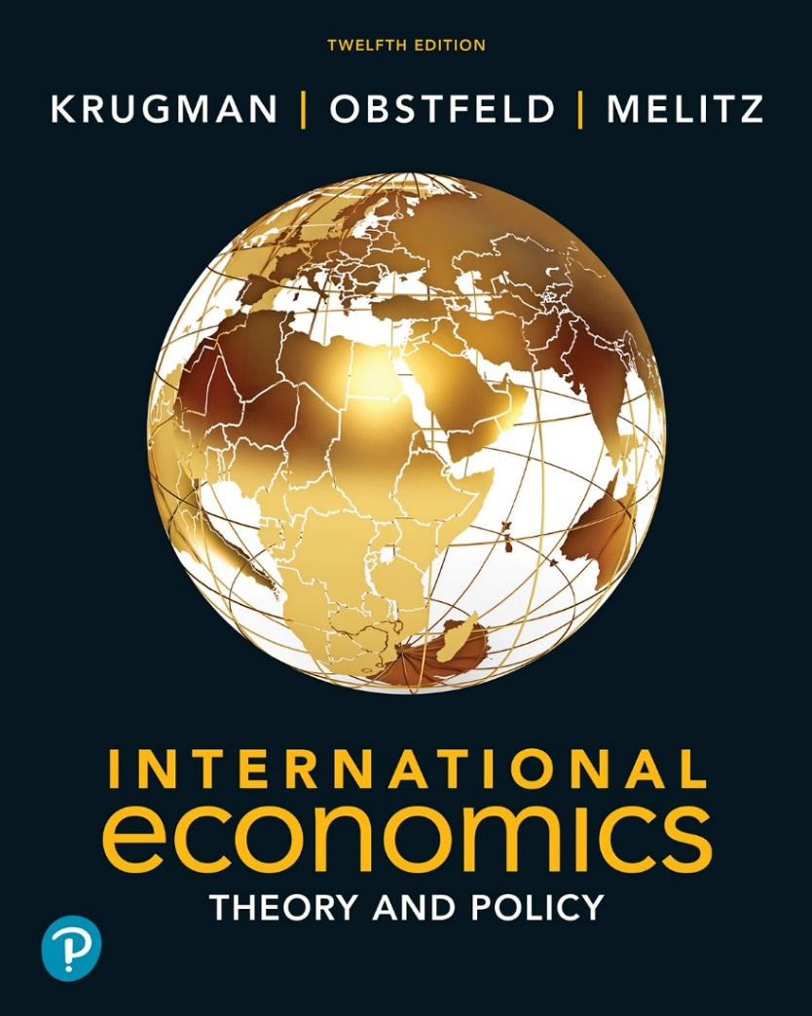

International Economics: Theory and Policy
Twelfth Edition
Chapter 2
World Trade: An Overview
Copyright © 2022, 2018, 2015 Pearson Education, Inc. All Rights Reserved
Notes:
If this PowerPoint presentation contains mathematical equations, you may need to check that your computer has the following installed:
1) MathType Plugin
2) Math Player (free versions available)
3) NVDA Reader (free versions available)

Slide 2
Learning Objectives
2.1 Describe how the value of trade between any two countries depends on the size of these countries’ economies and explain the reasons for that relationship.
2.2 Discuss how distance and borders reduce trade.
2.3 Describe how the share of international production that is traded has fluctuated over time and why there have been two ages of globalization.
2.4 Explain how the mix of goods and services that are traded internationally has changed over time.

Slide 3
Preview
Largest trading partners of the United States
Gravity model: Influence of an economy’s size on trade; Distance, barriers, borders, and other trade impediments
Globalization: then and now
Changing composition of trade
Service outsourcing

Slide 4
Who Trades with Whom?
More than 30 percent of world output is sold across national borders.
World trade in goods and services exceeded $25 trillion in 2019.
Figure 2-1 shows the total value of trade in goods—exports plus imports—between the United States and its top 15 trading partners in 2019.
The largest 15 trading partners with the United States accounted for 75 percent of the value of U.S. trade.
The five largest trading partners with the United States in 2019 were Mexico, Canada, China, Japan, and Germany.

Slide 5
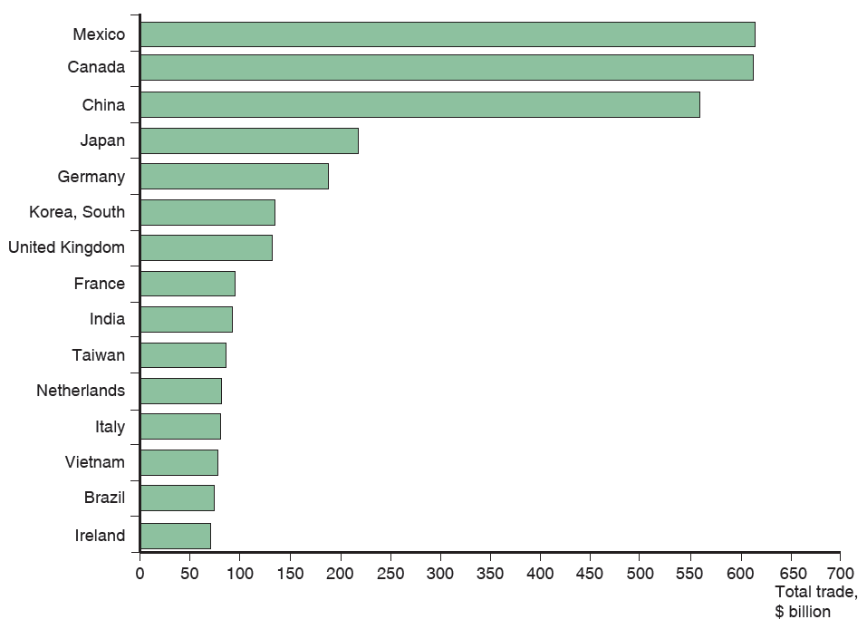
Figure 2.1 Total U.S. Trade with Major Partners, 2019
U.S. trade—measured as the sum of imports and exports—is mostly with 15 major partners.
Source: U.S. Department of Commerce.
Notes:
The horizontal bar graph lists countries versus total trade in billions of dollars. The list provides total trade, in billions of dollars, for each country as follows. China, 620. Canada, 610. Mexico, 570. Japan, 240. Germany, 19 0. South Korea, 165. United Kingdom, 160. France, 100. India, 90. Taiwan, 80. Netherlands, 78. Italy, 75. Vietnam, 70. Brazil, 65. Ireland, 60. All values are estimated.

Slide 6
Size Matters: The Gravity Model (1 of 3)
Three of the top 15 U.S. trading partners are European nations: Germany, the United Kingdom, and France.
Why does the United States trade more with these European countries than with others?
These three countries have the largest gross domestic product (G D P), the value of goods and services produced in an economy, in Europe.
Figure 2-2 shows that each European country’s share of U.S. trade with Europe is roughly equal to its share of European G D P.

Slide 7
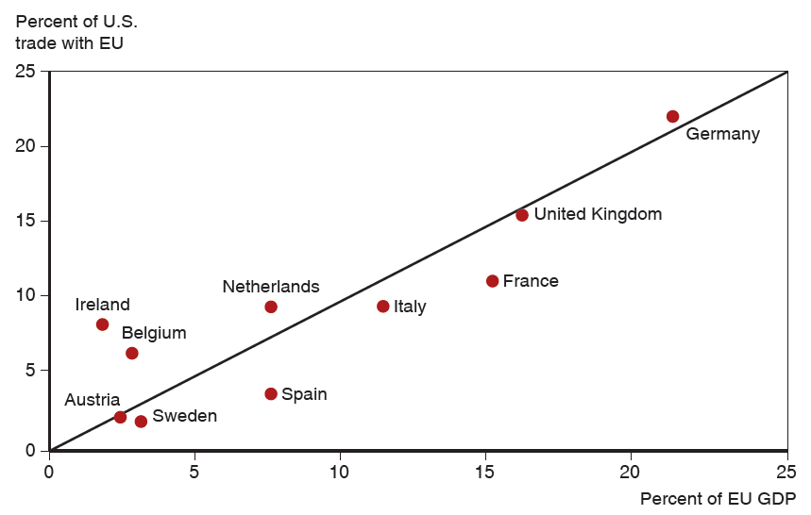
Figure 2.2 The Size of European Economies and the Value of Their Trade with the United States
Shows the correspondence between the size of different European economies and those countries’ trade with the United States.
Source: U.S. Department of Commerce, European Commission.
Notes:
A scatter diagram plots the percent of U S trade with the E U versus the percent of E U G D P. A line of best fit rises within the data from (0, 0) through (25, 25), with 10 countries plotted around the line. Austria and Sweden are clustered below the line at approximately points (3, 2). Ireland, Belgium and the Netherlands are above the line at (2, 8), (3, 6) and (9, 9), respectively. Spain, Italy, and France are below the line at (7, 3), (12, 8), and (16, 10) respectively. The highest points are the United Kingdom, (16, 15), and Germany, just above the line, at (22, 21). All values are estimated.

Slide 8
Size Matters: The Gravity Model (2 of 3)
The size of an economy is directly related to the volume of imports and exports.
Larger economies produce more goods and services, so they have more to sell in the export market.
Larger economies generate more income from the goods and services sold, so they are able to buy more imports.
Trade between any two countries is larger, the larger is either country.

Slide 9
Size Matters: The Gravity Model (3 of 3)
The gravity model assumes that size and distance are important for trade in the following way:
where A is a constant term
is the value of trade between country i and country j
the G D P of country i,
is the G D P of country j
is the distance between the two countries
Or more generally
where a, b, and c are allowed to differ from 1.

Slide 10
Using the Gravity Model: Looking for Anomalies
A gravity model fits the data on U.S. trade with European countries well but not perfectly.
The Netherlands, Belgium, and Ireland trade much more with the United States than predicted by a gravity model.
Ireland has strong cultural affinity due to common language and history of migration. Ireland also hosts many U.S.-based multinational corporations.
The Netherlands and Belgium have transport cost advantages due to their location.

Slide 11
Impediments to Trade: Distance, Barriers, and Borders (1 of 4)
Other things besides size matter for trade:
Distance between markets influences transportation costs and therefore the cost of imports and exports.
Cultural affinity: close cultural ties, such as a common language, usually lead to strong economic ties.
Geography: ocean harbors and a lack of mountain barriers make transportation and trade easier.
Multinational corporations: corporations spread across different nations import and export many goods between their divisions.
Borders: crossing borders involves formalities that take time, often different currencies need to be exchanged, and perhaps monetary costs like tariffs reduce trade.

Slide 12
Impediments to Trade: Distance, Barriers, and Borders (2 of 4)
Estimates of the effect of distance from the gravity model predict that a 1 percent increase in the distance between countries is associated with a decrease in the volume of trade of 0.7 percent to 1 percent.
Besides distance, borders increase the cost and time needed to trade.
Trade agreements between countries are intended to reduce the formalities and tariffs needed to cross borders and, therefore, to increase trade.

Slide 13
Impediments to Trade: Distance, Barriers, and Borders (3 of 4)
The United States signed a free trade agreement with Mexico and Canada in 1994, the North American Free Trade Agreement (N A F T A), which was replaced in 2020 with a slightly modified agreement, the U.S.-Mexico-Canada agreement (U S M C A).
Due to N A F3T.A and because Mexico and Canada are close to the United States, the amount of trade between the United States and its northern and southern neighbors as a fraction of G D P is much larger than between the United States and European countries.
Canada’s economy is roughly the same size as Spain’s (around 10 percent of E U G D P) but Canada trades as much with the United States as does all of Europe.

Slide 14
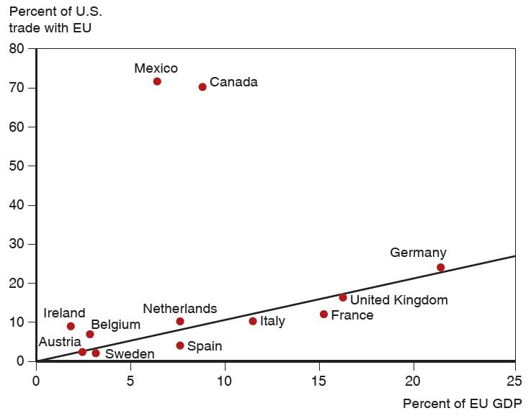
Figure 2.3 Economic Size and Trade with the United States
The United States does markedly more trade with its neighbors than it does with European economies of the same size.
Source: U.S. Department of Commerce, European Commission.
Notes:
The scatter diagram plots the percent of U S trade with the E U versus the percent of E U G D P. A line of best fit rises within the data from (0, 0) through (25, 25), with 12 countries, including Mexico and Canada, plotted way above the line. European countries listed are below 20% of U S trade with E U, with the exception of Germany, which has the highest percentages at (22, 25). Mexico and Canada are above the line at points, (7, 75) and (10, 70), respectively. All values are estimated.

Slide 15
Impediments to Trade: Distance, Barriers, and Borders (4 of 4)
Yet even with a free trade agreement between the United States and Canada, which mostly use a common language, the border between these countries still reduces trade.
Data shows that there is much more trade between pairs of Canadian provinces than between Canadian provinces and U.S. states, even when holding distance constant.
Estimates indicate that the U.S.-Canadian border deters trade as much as if the countries were 1,500–2,500 miles apart.

Slide 16
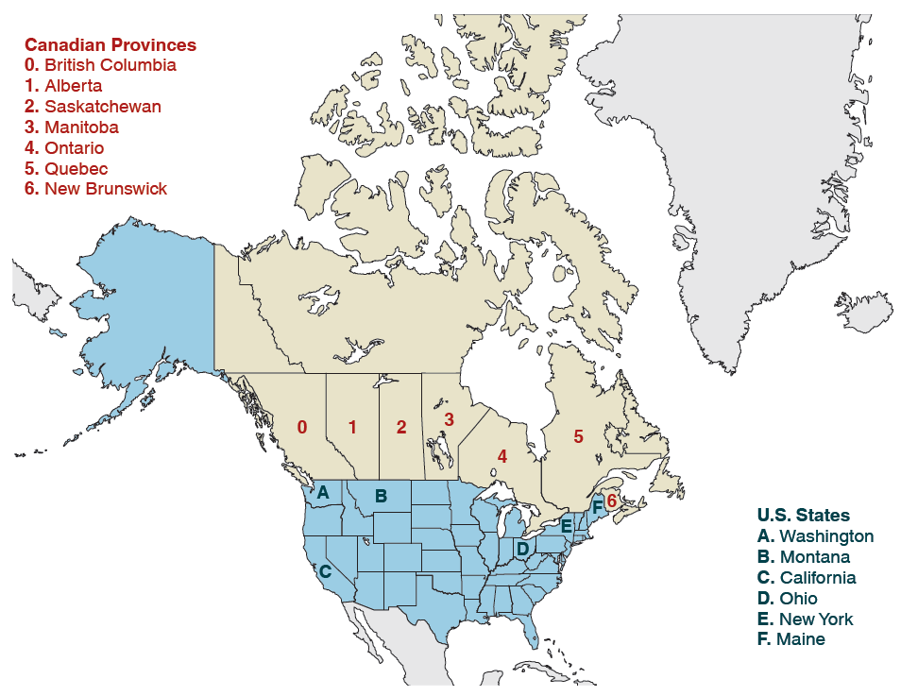
Figure 2.4 Canadian Provinces and U.S. States that Trade with British Columbia
Source: Statistics Canada, U.S. Department of Commerce.
Notes:
The following list provides the 6 Canadian provinces that trade with British Columbia, from east to west as follows. Alberta, Saskatchewan, Manitoba, Ontario, Quebec, and New Brunswick. The 6 U S states that trade with New Brunswick are as follows. In the northwest, Washington and Montana. On the west coast, California. In central east U S, Ohio. In the northeast, New York, and Maine.

Slide 17
Table 2.1 Trade with British Columbia, as Percent of G D P, 2009
Canadian Province | Trade as Percent of G D P | Trade as Percent of G D P | U.S. State at Similar Distance From British Columbia
Alberta | 6.9 | 2.6 | Washington
Saskatchewan | 2.4 | 1.0 | Montana
Manitoba | 2.0 | 0.3 | California
Ontario | 1.9 | 0.2 | Ohio
Quebec | 1.4 | 0.1 | New York
New Brunswick | 2.3 | 0.2 | Maine
Source: Statistics Canada, U.S. Department of Commerce.

Slide 18
The Changing Pattern of World Trade: Has the World Gotten Smaller? (1 of 3)
The negative effect of distance on trade according to the gravity models is significant, but it has grown smaller over time due to modern transportation and communication.
A global economy, with strong economic linkages between even distant nations, is not new.
There have been two great waves of globalization with the first wave relying not on jets and the Internet but on railroads, steamships, and the telegraph.

Slide 19
The Changing Pattern of World Trade: Has the World Gotten Smaller? (2 of 3)
Political factors, such as wars, can change trade patterns much more than innovations in transportation and communication.
World trade grew rapidly from 1870 to 1913.
Then it suffered a sharp decline due to the two world wars and the Great Depression.
It started to recover around 1945 but did not recover fully until around 1970.

Slide 20
The Changing Pattern of World Trade: Has the World Gotten Smaller? (3 of 3)
Since 1970, world trade as a fraction of world G D P has achieved unprecedented heights.
Vertical disintegration of production has contributed to the rise in the value of world trade through extensive cross-shipping of components.
A $100 product can give rise to $200 or $300 worth of international trade flows.

Slide 21
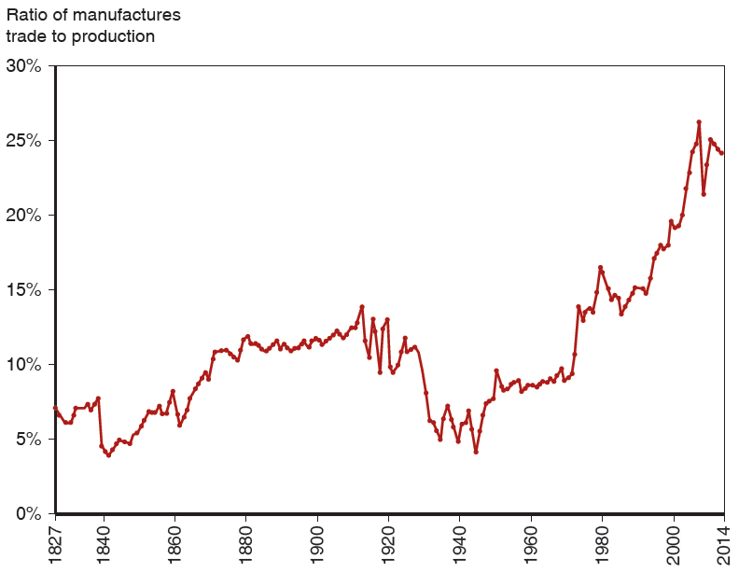
Figure 2.5 The Fall and Rise of World Trade
The ratio of world exports to world G D P rose in the decades before World War
but fell sharply in the face of wars and protectionism. It didn’t return to 1913 levels until the 1970s but has since reached new heights.
Source: Michel Fouquin and Jules Hugot, “Trade Globalisation in the Last Two Centuries,” Voxeu (September 2016).
Notes:
The graph plots ratio of manufactures trade to production versus year. The plot generally rises from (18 27, 7%) to (20 14, 22%). A significant drop occurs from (18 39, 8%) to (18 40, 4.5%), before a rise to (18 60, 8.5%). The plot then significantly drops from (19 10, 13%), to (19 50, 4%), before a rise back to (19 55, 8%). The graph displays fluctuating behavior with high and lows in the intermediate points. All values are estimated.

Slide 22
What Do We Trade? (1 of 3)
What kinds of products do nations trade now, and how does this composition compare to the past?
Most (about 70 percent) of the volume of trade today is in manufactured products such as automobiles, computers, and clothing.
Fuels and mining products (e.g., petroleum, coal, and copper) remain an important part of world trade at 15 percent.
Agricultural products are a relatively small part of trade at 10 percent.

Slide 23
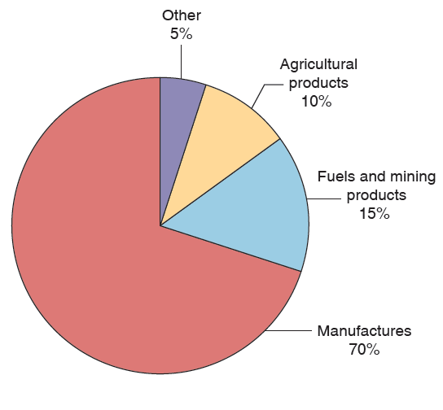
Figure 2.6 The Composition of World Trade, 2017
Most world trade is in manufactured goods, but minerals—mainly oil—remain important.
Source: World Trade Organization.

Slide 24
What Do We Trade? (2 of 3)
In the past, a large fraction of the volume of trade came from agricultural and mineral products.
In 1910, Britain mainly imported agricultural and mineral products, although manufactured products still represented most of the volume of exports.
In 1910, the United States mainly imported and exported agricultural products and mineral products.
In 2002, manufactured products made up most of the volume of imports and exports for both countries.

Slide 25
Table 2.2 Manufactured Goods as Percent of Merchandise Trade
Blank | Exports of United Kingdom | Imports of United Kingdom | Exports of United States | Imports of United States
1910 | 75.4 | 24.5 | 47.5 | 40.7
2015 | 72.3 | 73.6 | 74.8 | 78.4
Source: 1910 data from Simon Kuznets, Modern Economic Growth: Rate, Structure and Speed. New Haven: Yale Univ. Press, 1966. 2015 data from World Trade Organization.

Slide 26
What Do We Trade? (3 of 3)
Low- and middle-income countries have also changed the composition of their trade.
In 2001, about 65 percent of exports from low- and middle-income countries were manufactured products, and only 10 percent of exports were agricultural products.
In 1960, about 58 percent of exports from low- and middle-income countries were agricultural products and only 12 percent of exports were manufactured products.
More than 90 percent of the exports of China, the largest developing country and a rapidly growing force in world trade, consist of manufactured goods.

Slide 27
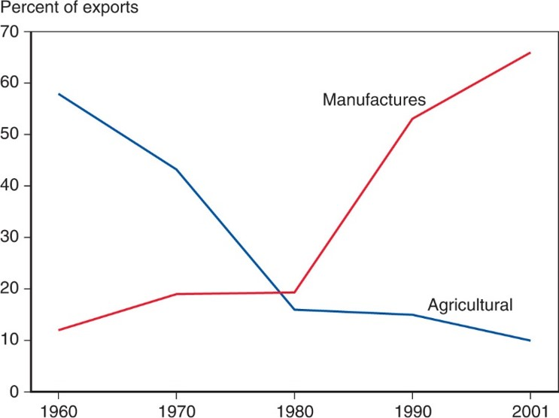
Figure 2.7 The Changing Composition of Developing-Country Exports
Over the past 50 years, the exports of developing countries have shifted toward manufactures.
Source: United Nations Council on Trade and Development.
Notes:
The graph plots the percent of exports versus year, from 19 60 to 20 01. The plot for manufactures rises gradually from (19 60, 12) to (19 80, 18) and then rises steeply to (20 01, 68). The plot for agricultural falls steeply from (19 60, 58) to (19 80, 14) and then falls less steeply to (20 01, 10). The graphs intersect at (19 79, 18). All values are estimated.

Slide 28
Service Offshoring (1 of 2)
Service offshoring (or outsourcing) occurs when a firm that provides services moves its operations to a foreign location.
Service outsourcing can occur for services that can be transmitted electronically.
A firm may move its customer service centers whose telephone calls can be transmitted electronically to a foreign location.
Other services may not lend themselves to being performed remotely.

Slide 29
Service Offshoring (2 of 2)
Service outsourcing is currently not a significant part of trade.
Some jobs are “tradable” and thus have the potential to be outsourced.
Most jobs (about 60 percent) need to be done close to the customer, making them nontradable.

Slide 30
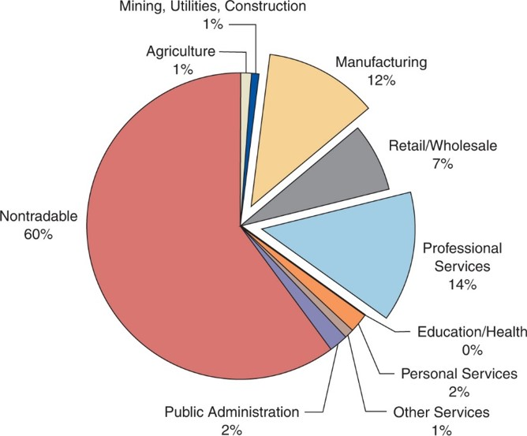
Figure 2.8 Tradable Industries’ Share of Employment
Estimates based on trade within the United States suggest that trade in services may eventually become bigger than trade in manufactures.
Source: J. Bradford Jensen and Lori G. Kletzer, “Tradable Services: Understanding the Scope and Impact of Services Outsourcing,” Peterson Institute of Economics Working Paper 5–09, May 2005.
Notes:
The pie chart has 10 sections of industries with percentages as follows. Non tradable, 60. Professional services, 14. Manufacturing, 12. Retail and wholesale, 7. Public administration, 2. Personal services, 2. Agriculture, 1. Mining, utilities, construction, 1. Other services, 1. Education and health, 0.

Slide 31
Do Old Rules Still Apply?
The sources of modern trade are more subtle than before.
Human resources and human-created resources (in the form of machinery and other types of capital) are more important than natural resources.
Political battles over trade typically involve workers whose skills are made less valuable by imports, such as clothing workers who face competition from imported apparel, and tech workers who now face competition from Bangalore.
Even though much about international trade has changed, the fundamental principles discovered by economists at the dawn of a global economy still apply, as we shall see in the upcoming chapters about why international trade occurs.

Slide 32
Summary (1 of 2)
The five largest trading partners with the United States are Mexico, Canada, China, Japan, and Germany.
The largest economies in the E U undertake the largest fraction of the total trade between the E U and the United States.
The gravity model relates the trade between any two countries to the sizes of their economies. Using the gravity model also reveals the strong effects of distance and international borders in discouraging trade.

Slide 33
Summary (2 of 2)
International trade is at record levels relative to the size of the world economy, thanks to falling costs of transportation and communications. The world was highly integrated in 1914, but trade was greatly reduced by economic depression, protectionism, and war and took decades to recover.
Manufactured goods dominate modern trade today. In the past, however, primary products were much more important than they are now.
Developing countries, in particular, have shifted from being mainly exporters of primary products to being mainly exporters of manufactured goods.

Slide 34

Copyright
This work is protected by United States copyright laws and is provided solely for the use of instructors in teaching their courses and assessing student learning. Dissemination or sale of any part of this work (including on the World Wide Web) will destroy the integrity of the work and is not permitted. The work and materials from it should never be made available to students except by instructors using the accompanying text in their classes. All recipients of this work are expected to abide by these restrictions and to honor the intended pedagogical purposes and the needs of other instructors who rely on these materials.

